Slide 1

Noam Gariani, Will Tatum, Patrick Cannell,
Christopher Muniz, and Matthew Atanas

Slide 2
Project Development Lifecycle
Agile methodology
1 week sprints
4 sprints total
Daily meetings every weekday at 5:45pm with optional weekend meetings or extended meetings
Meetings on Wednesday at 5:45pm with client
Meetings on Thursday at 5:45pm with professor

Slide 3
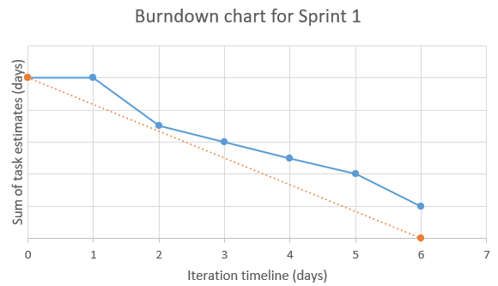
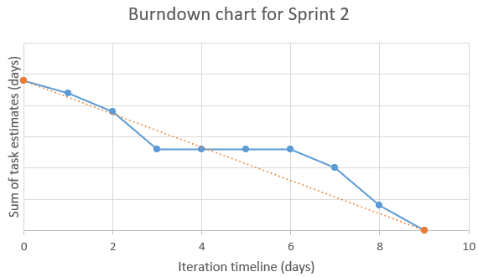
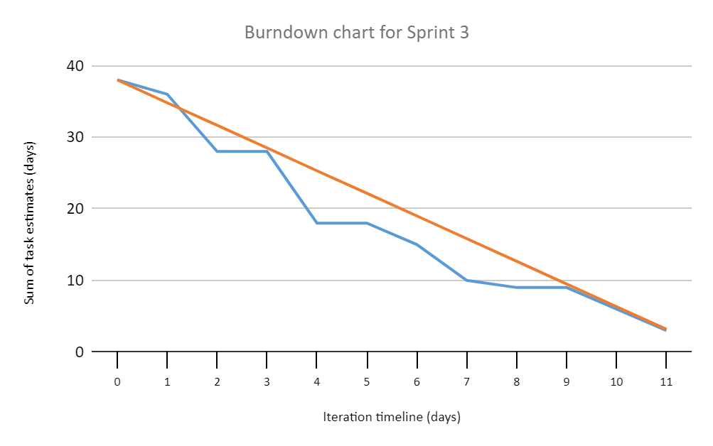
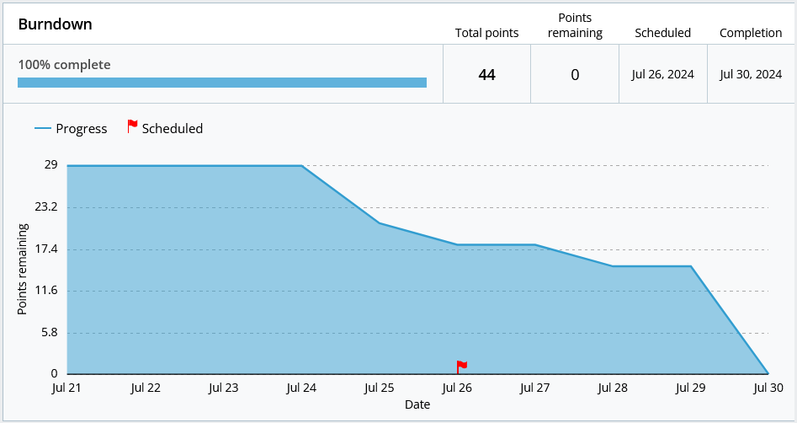
Stories
109 total points
Sprint 1: 10 points
Sprint 2: 24 points
Sprint 3: 33 points
Sprint 4: 44 points
Sprint 4:
Insert total burndown chart here

Slide 4
Hosting, Database, and Tools
Heroku for hosting the website and database
Postgresql for the database
Rubocop for code style
CodeClimate for code quality
Cucumber for behavior testing
Rspec for specification testing

Slide 5
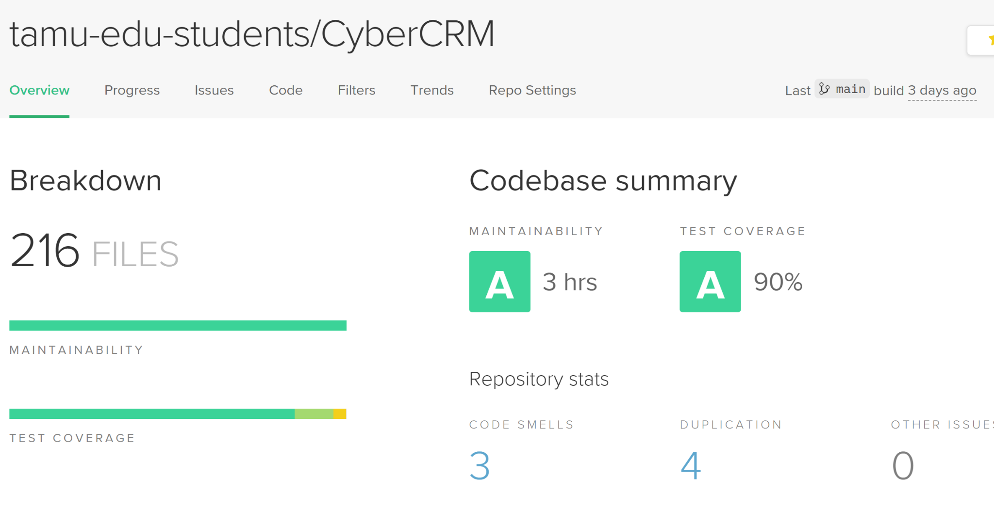
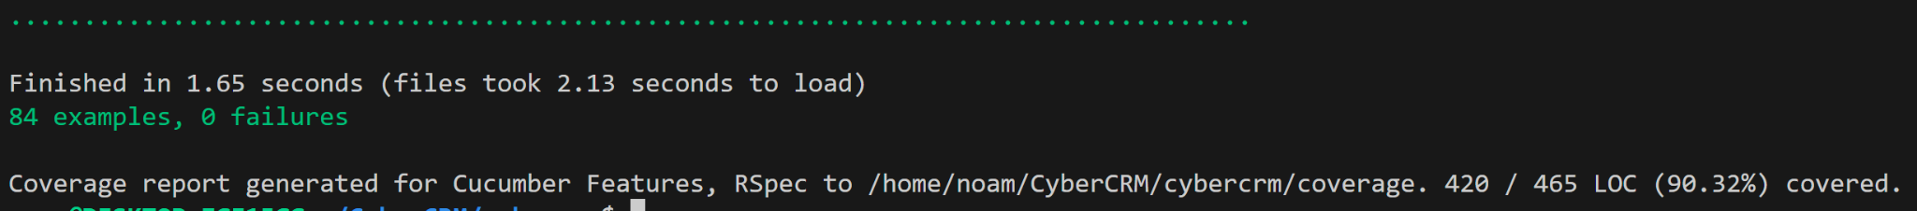
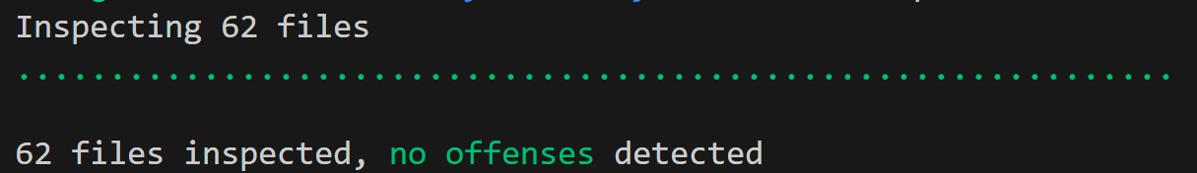
Github Actions
Needed to pass rspec tests
Needed to pass cucumber tests
Needed to have 90% coverage minimum
Needed to pass linting including code style
Upload test results to CodeClimate
RSpec
Cucumber
Rubocop

Slide 6
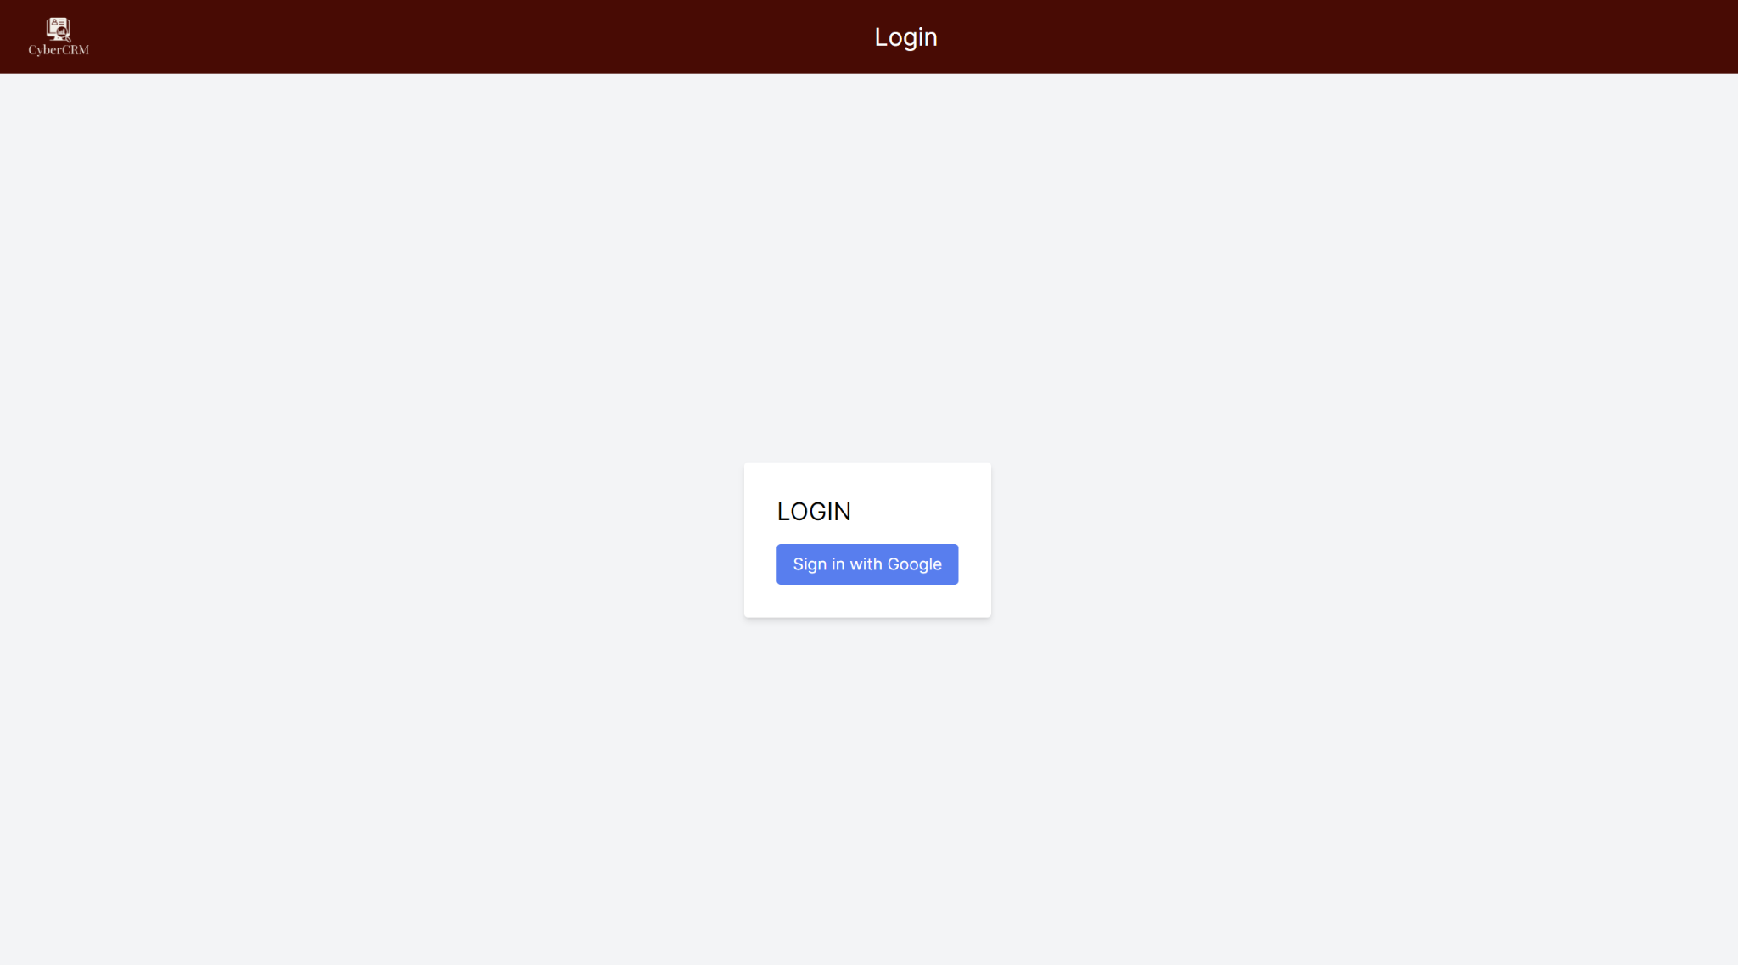
Login Page
This is where you login.

Slide 7
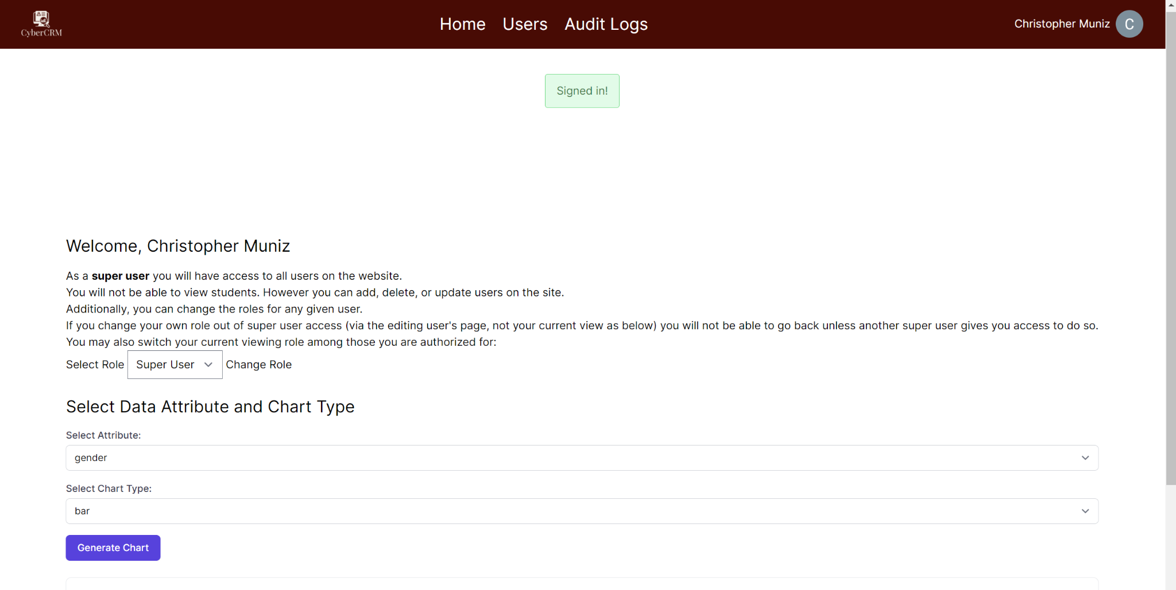
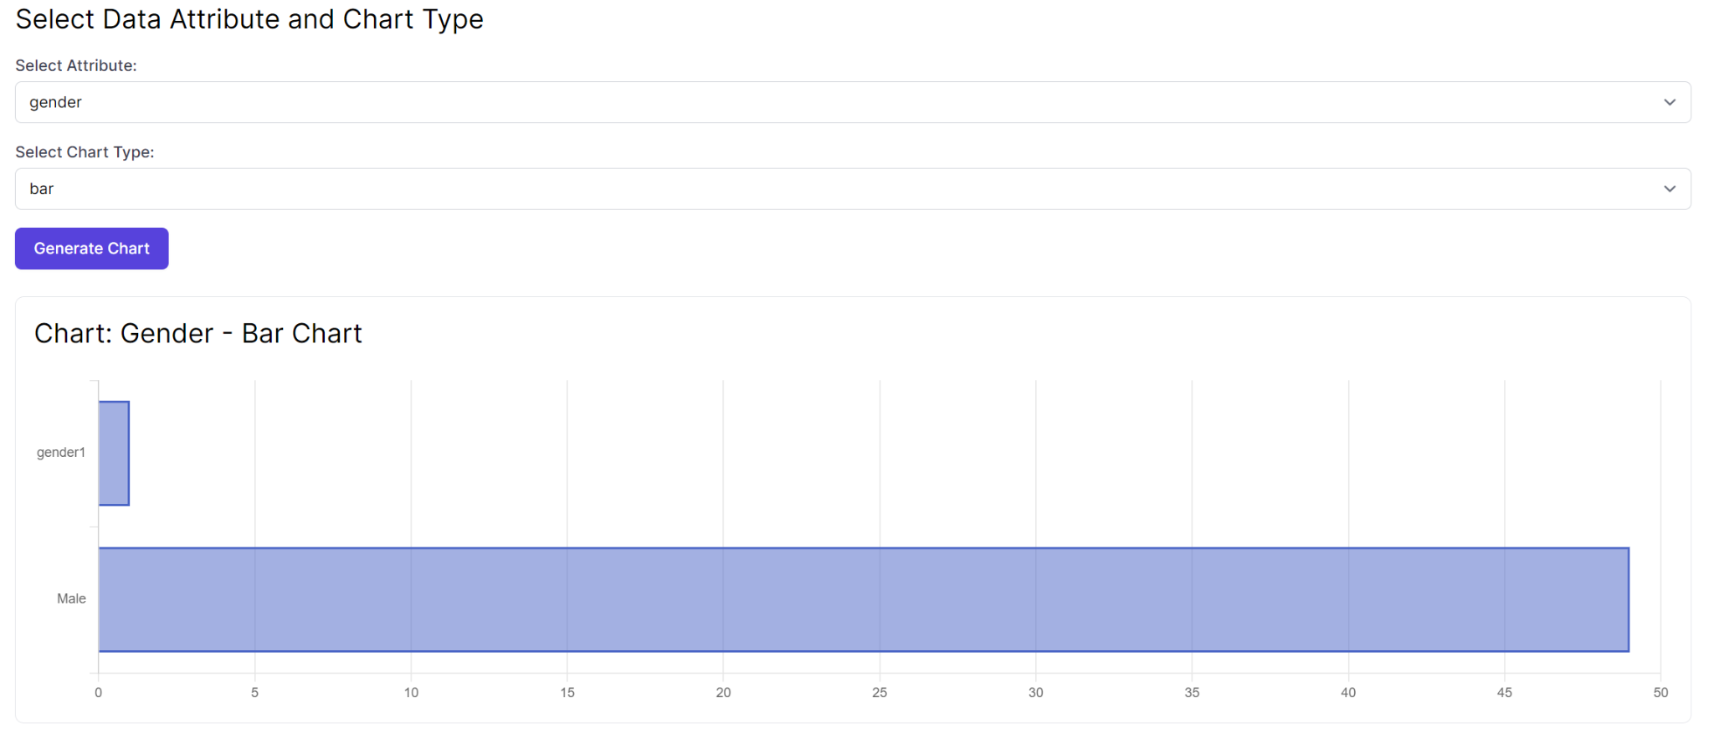
Home Page
This is where you can see graphs of student data and change your role.

Slide 8
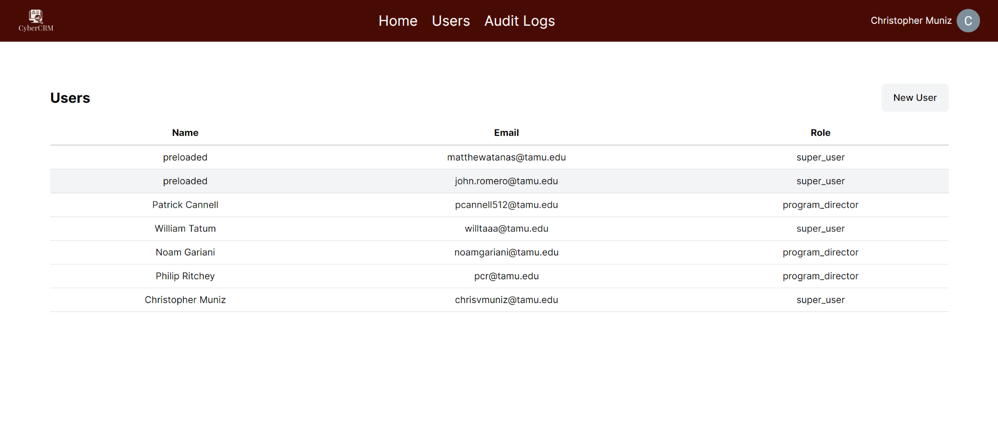
Users Page
This is where you can create, read, update, and delete users.

Slide 9
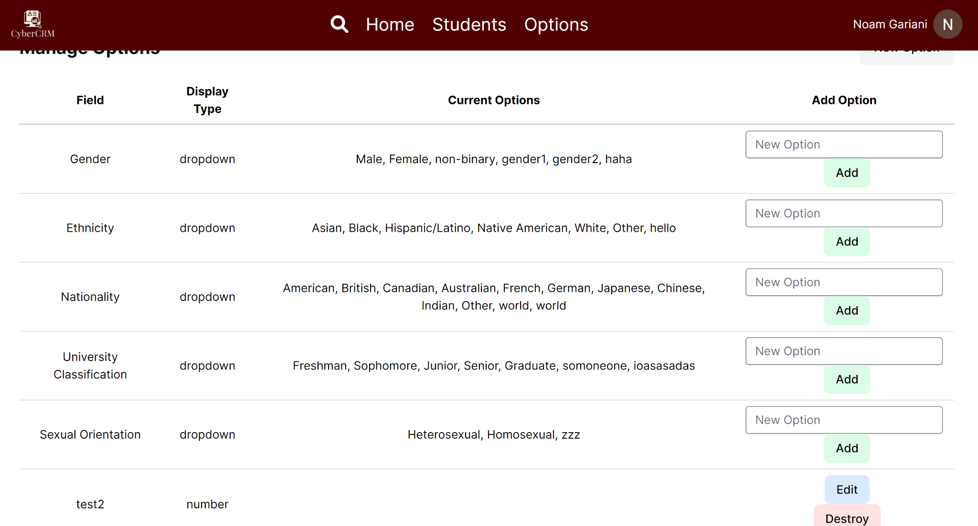
Options Page
This is where you can create, read, update, and delete options.

Slide 10
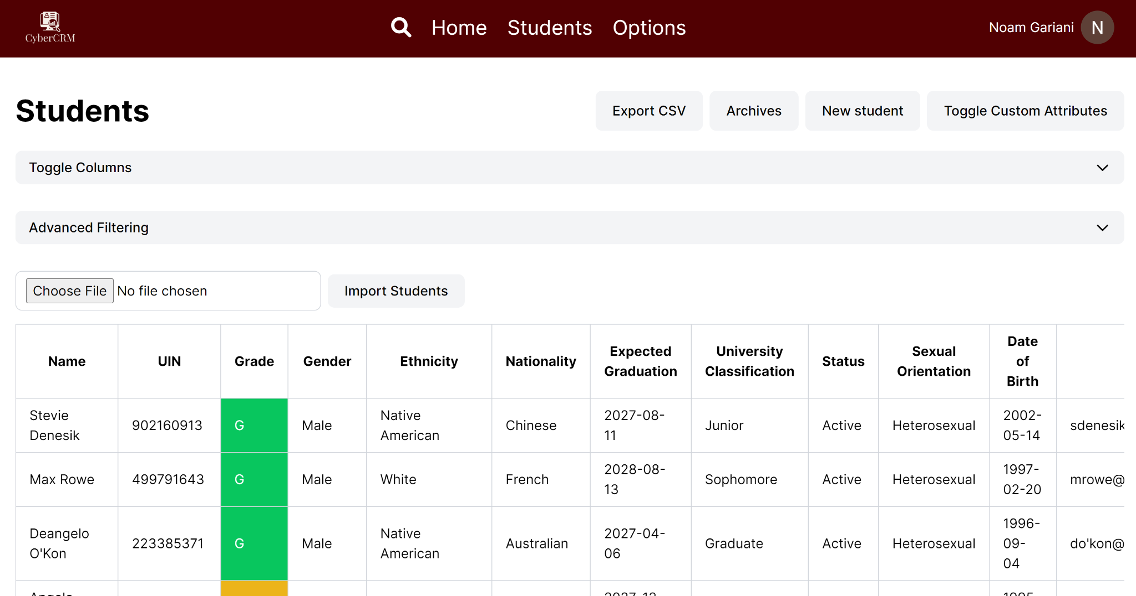
Students Page
This is where you can view the table containing students and also create, read, update, and delete students.

Slide 11
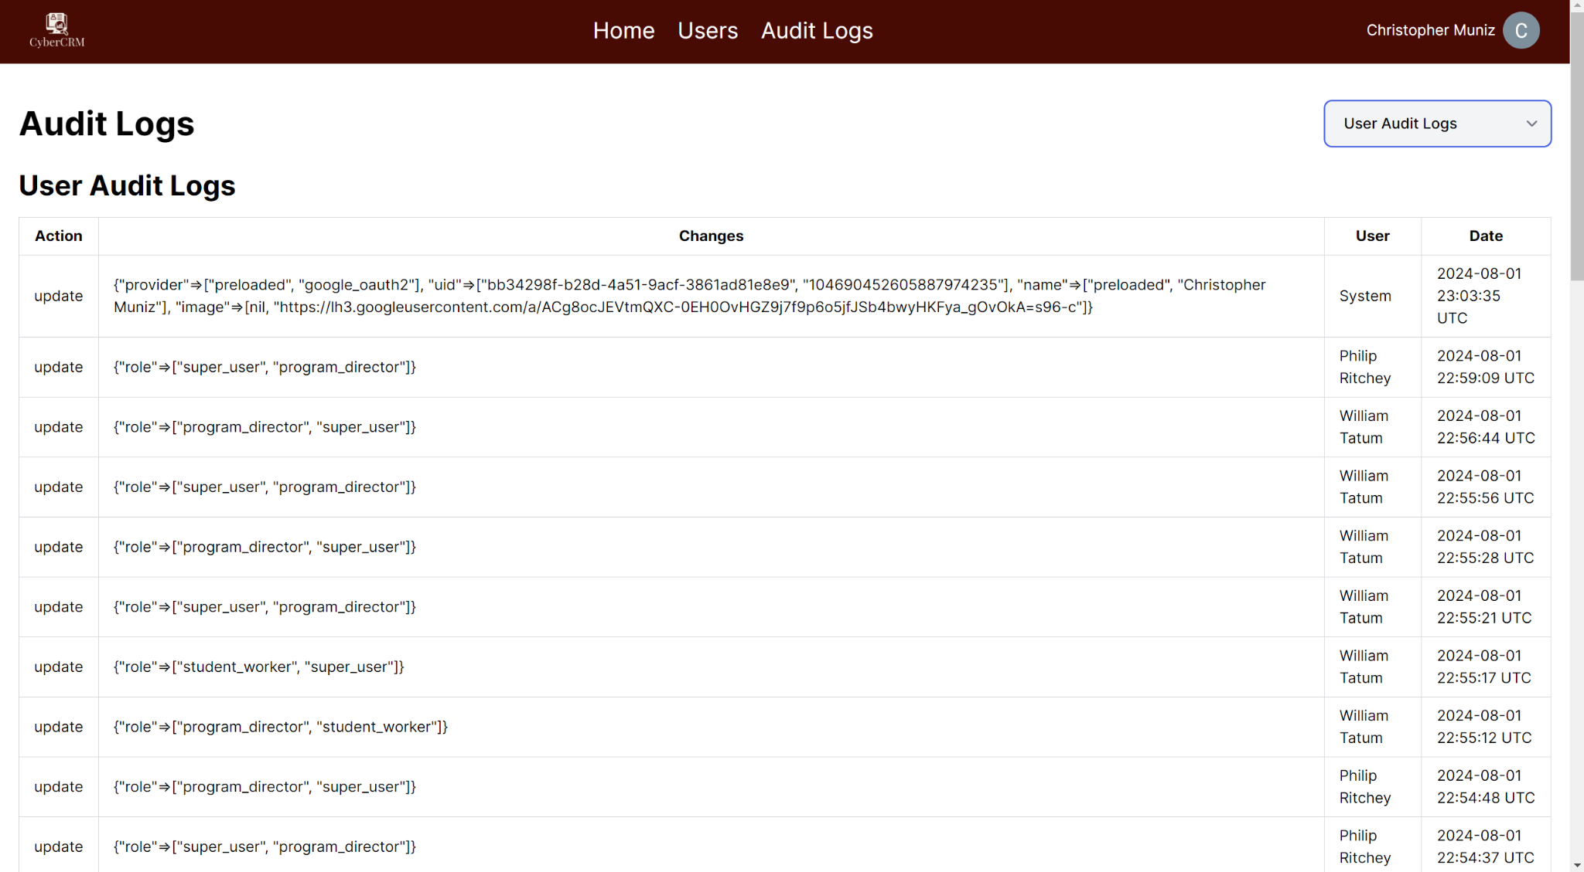
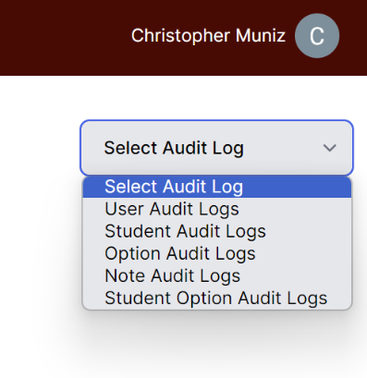
Audit Log Page
This is the page where you can view any and all modifications to any of the models in the website.

